Slide 2
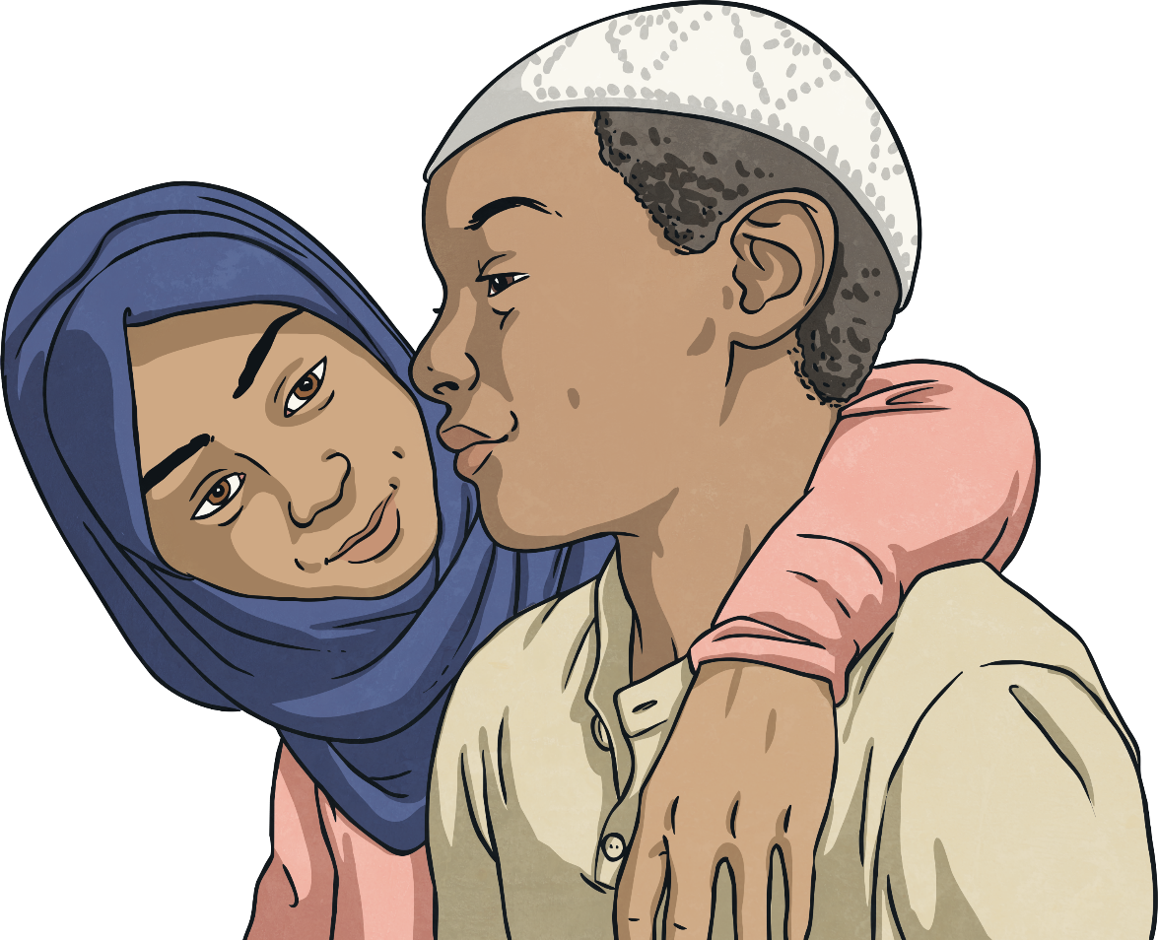
Islam
Islam is the world’s second largest
religion. It teaches that God is merciful,
powerful and unique and that people
can call on God when they are in need
and distressed. He is known as Allah.
It is believed that the last prophet
was Muhammad. Prophet
Muhammad is so important to
Muslims that whenever they say
his name, they also say 'Peace
be upon him', and when they
write his name they write it
but sometimes shorten it
to PBUH.
People who follow Islam are known
as Muslims. Muslims believe that
Islam has always existed and
was revealed to them through
a number of people called
prophets.
Did you know…? The word prophet means ‘messenger’.

Slide 3
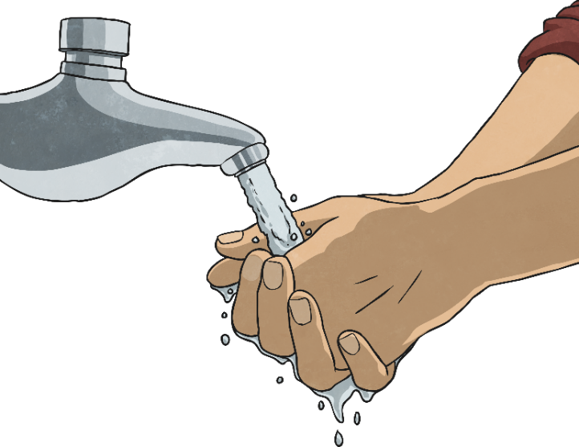
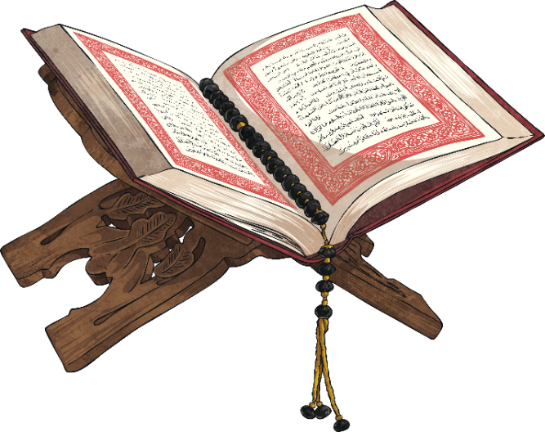
The Qur’an
The Qur’an, which is written in Arabic, is the scripture of Islam. Muslims believe it was revealed by God to a number of prophets and that it is the word of God. It provides guidance to teach people right and wrong.
Anyone who handles or touches the Qur’an has to follow certain rules. They must be clean and wash in special ways called ablutions.

Slide 4
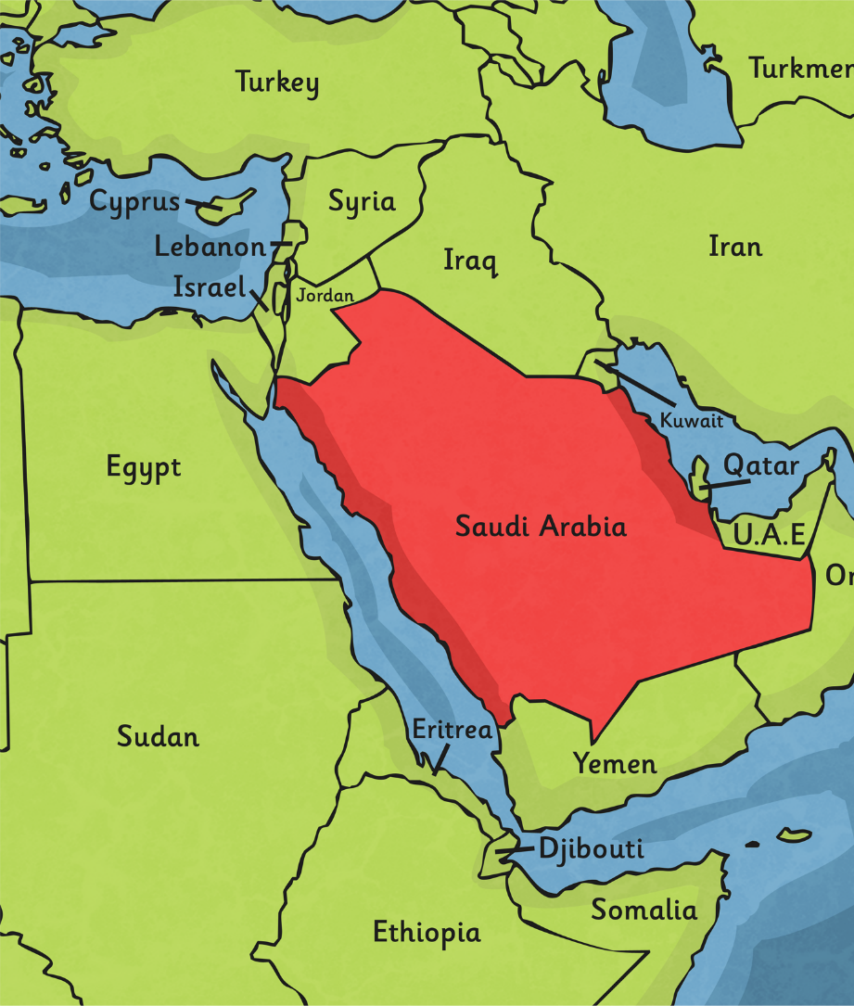
The Revelation of the Qur’an
Muhammad was born in Mecca in Saudi Arabia in AD 570. He worked as a merchant and became known for his honesty. He was a deeply spiritual person and would often meditate on Mount Hira.
In AD 610, he was meditating in a cave on Mount Hira when the Angel Gabriel appeared to him. The angel spoke to him.
The angel said the word ‘Allah’ and Muhammad began to recite words which he believed came straight from God. This was his first revelation from God.

Slide 5
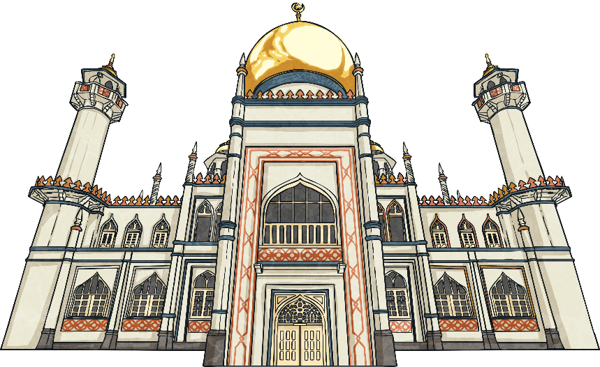
Prophet Muhammad
Over the next 22 years, Muhammad received revelations from God. These revelations were written down as the Qur’an. From that time, Muhammad was known as Prophet Muhammad and he preached about the revelations for the rest of his life. He is recognised as the founder of Islam.
Prophet Muhammad believed God had chosen him to preach what had been revealed to him and tell the world.
The principle message is that there is no God but Allah and that life should be lived in submission to Allah.

Slide 6
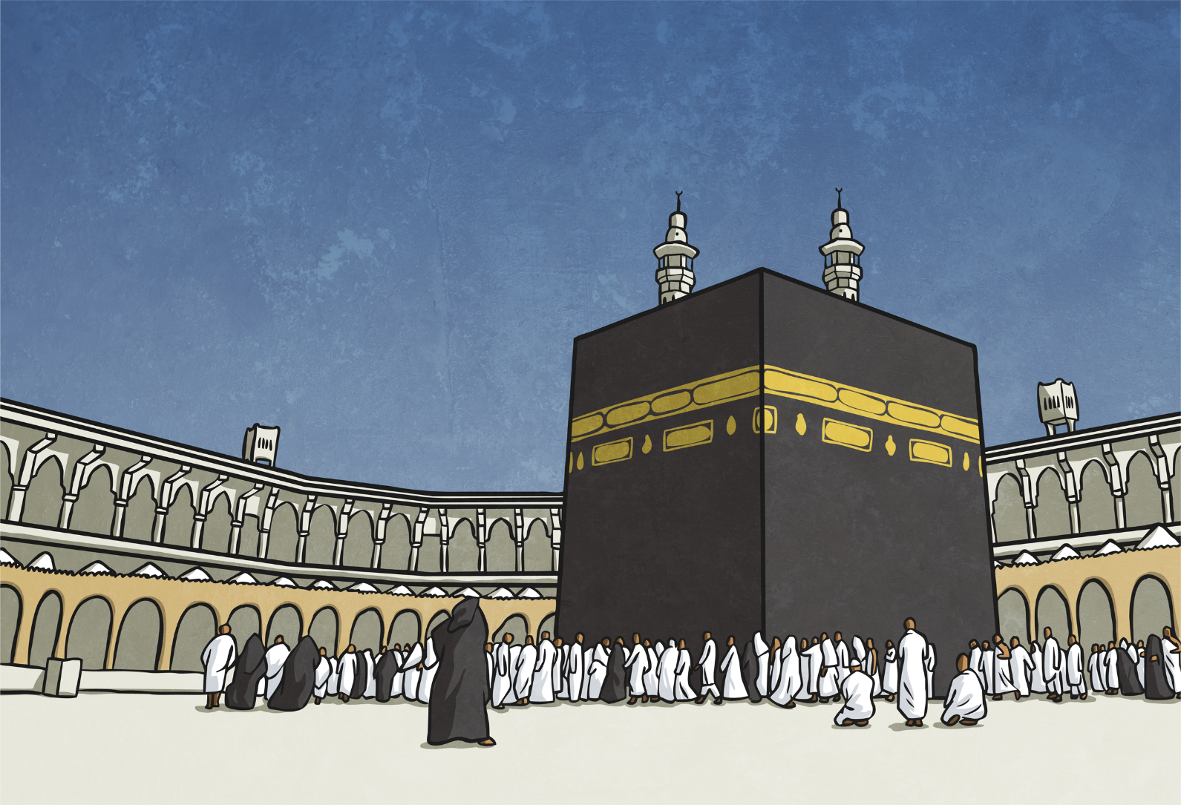
Pilgrimages
Prophet Muhammad died in AD 632 in Medina. He is buried there. He is recognised as being the last prophet of Islam. Many Muslims travel on pilgrimages to the birth place of Muhammad as a sign of respect and to pray. Many also travel to Medina, where he died.
Mecca

