Slide 1
Noun Phrases
Describing
Nouns
Adverbs
Imagining
Adjectives
Being specific
Creating a picture

Slide 2
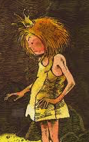
Creating good descriptions
Adjectives tell us more about nouns.
Tell me more about the princess
Don’t forget the comma!
The princess
The clever, scruffy princess
Finish the sentence
The clever, scruffy princess in the cave…
The clever, scruffy princess in the cave was not what the prince expected.

Slide 3
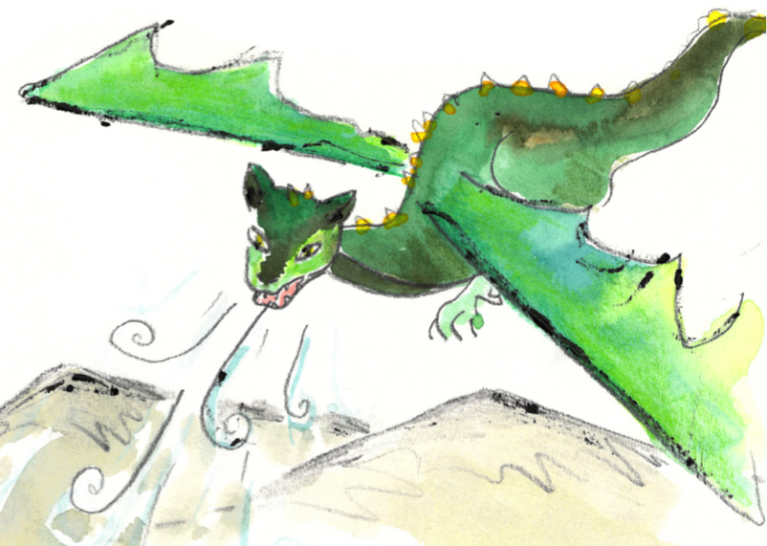
Highlight the adjective
Highlight the adverb
Noun phrases
Noun phrase = the words giving more detail about a noun
What is the noun being described?
Which dragon?
dragon
A dragon
Where?
dragon
A dragon in the sky
Tell me more about the dragon
A dragon in the sky over the mountains
dragon
scary
dragon
A scary dragon in the sky over the mountains
There was a really scary dragon in the sky over the mountains.
really
scary
dragon

Slide 4
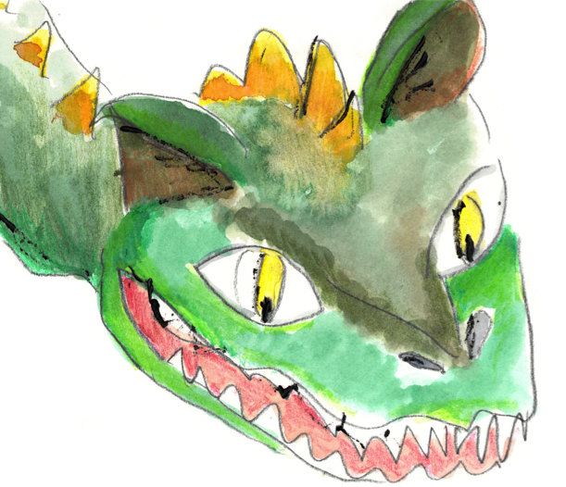
Noun phrase
Now you have a go…
A dragon
Start with a noun.
A dragon on the mountain
Add description about what, where or when.
A very scary dragon on the mountain above the town.
Add adjectives and adverbs.
Hint!
Think of something really good to describe.

