Slide 1
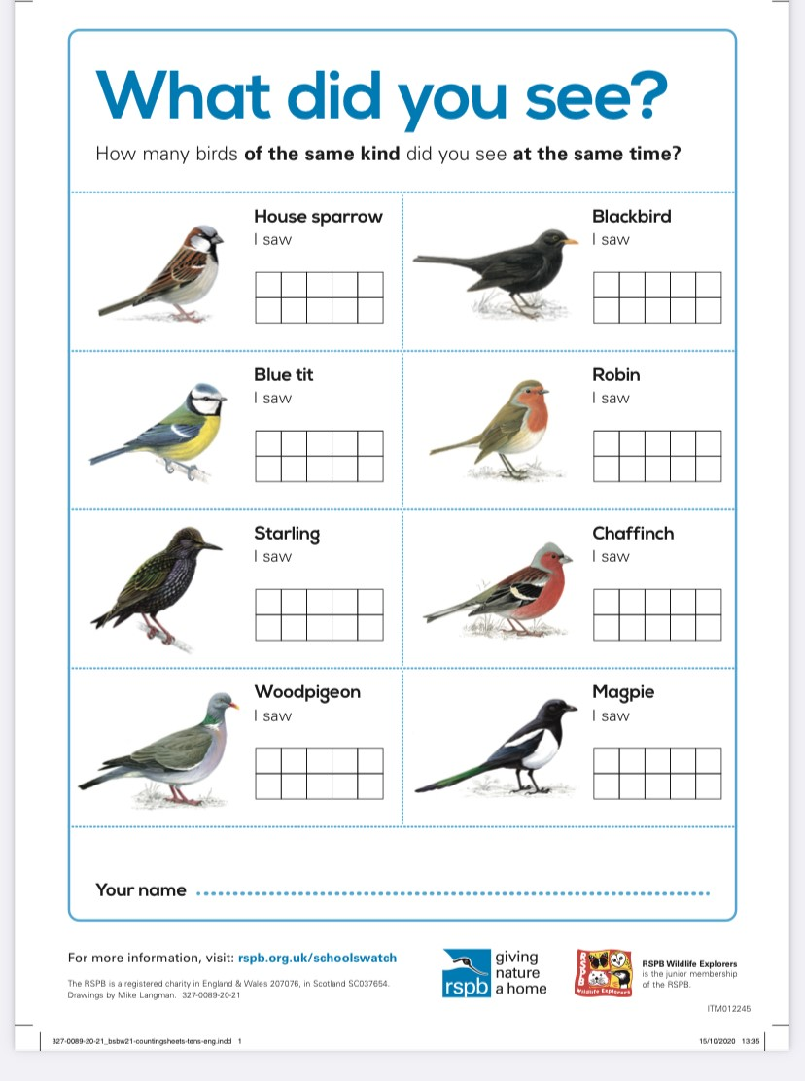
Half Term Challenge
During the week commencing the 15th February see if you can go for a walk or get out in your garden.
Each day have a look and record which birds you see. Mark the day of the week in the box every time you see one.
Return your completed sheets to collettepriestman@hotmail.com
Please make sure you have your name and school on the sheet.

