Slide 1
Planting and looking after our seeds

Slide 2
Planting and looking after our seeds
Now I making my seed packet

Slide 3
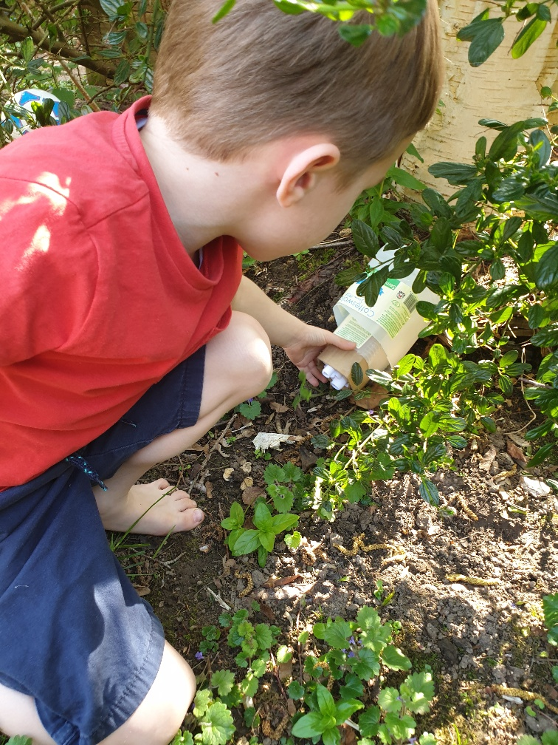
Now we are making bug hotels
This looks like a good place to visit
Who will be my first guest?

