Slide 1
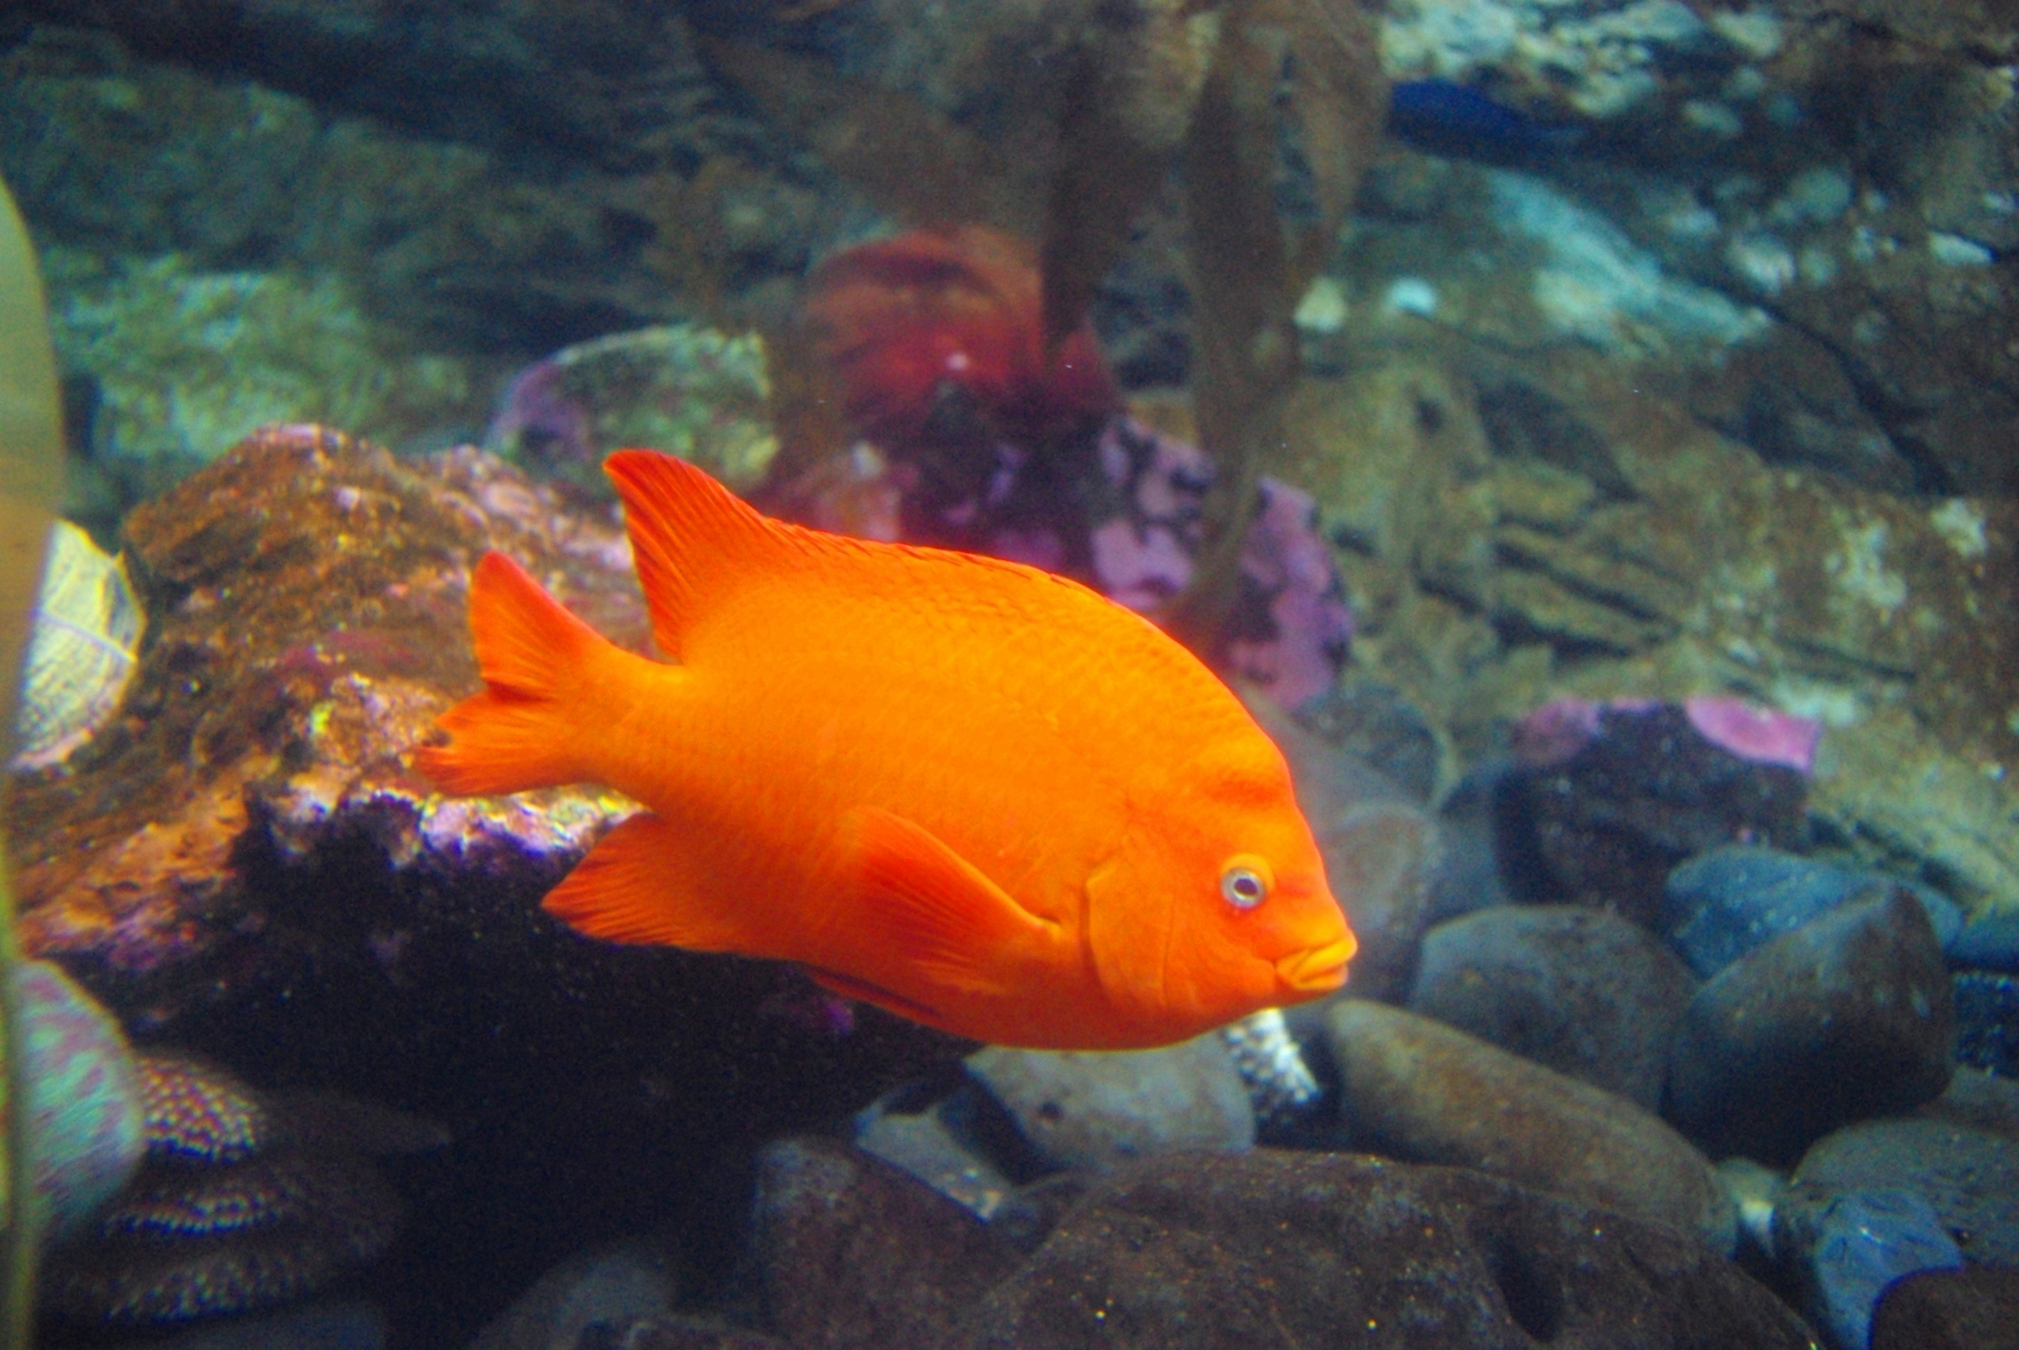
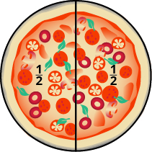
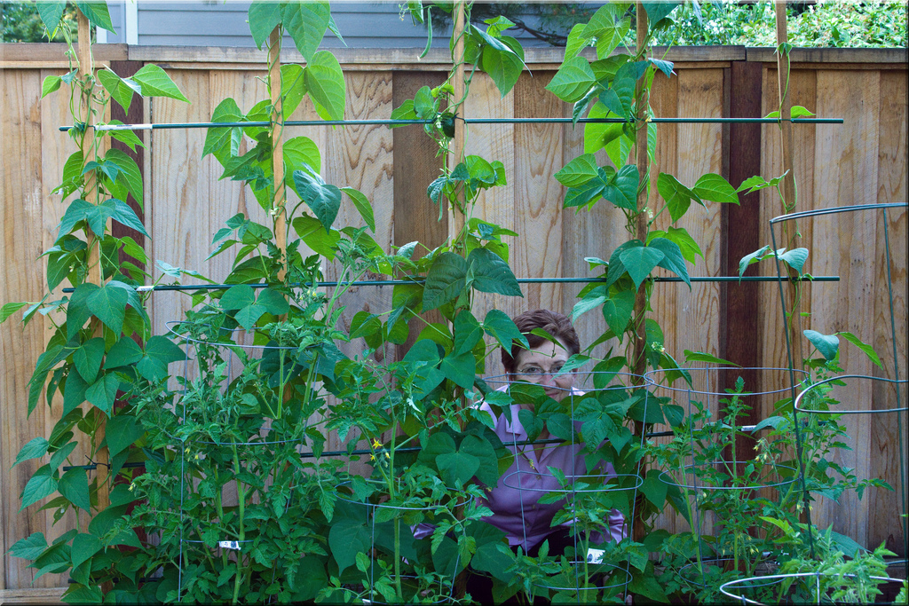
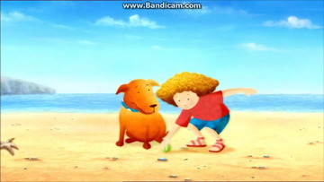
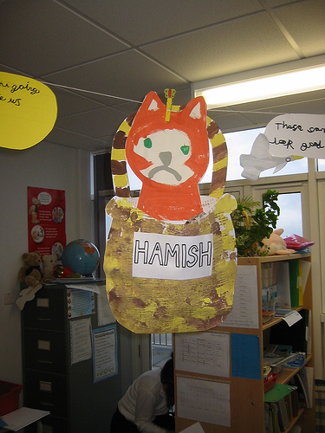
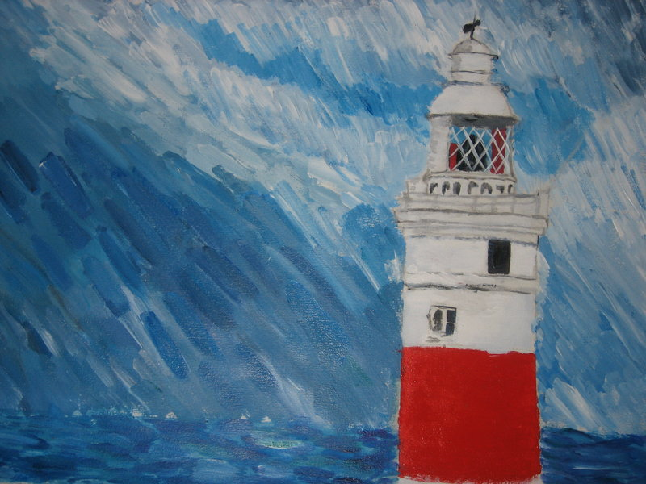
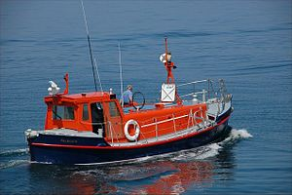
All at Sea Roe Class Summer 2022
Literacy
ENGLISH
Phases 3 & 4 phonics, reading phase 4 tricky words ~ said, so, have, like, some, come, were, there, little, one. Adapting stories with familiar patterns, writing simple sentences in a variety of contexts. Key stories ~ Rainbow Fish, Sand Dragon, Ebb and Flo and the Greedy Gulls, The Lighthouse Keeper’s Lunch, Brilliant Boats, Somebody Swallowed Stanley.
MATHS
Communication & Language
C
Doubling numbers 1,2,3,4,5. Counting on & back for addition and subtraction, sharing and halving, odd and even, counting beyond 20, naming 3D shapes. (Exploring weight, length, capacity, time, money, spatial reasoning through play and stories.)
Following stories and explaining understanding. Responding to how and why questions. Developing own narratives through role play.
The World
RE
What do I need to do to make this bean grow? Growing beans and sunflowers. What plants need. Keeping a class bean diary. Instructions for planting a seed. Investigating seeds in the food we eat. Beebot visits the garden. Investigating sea creatures, at the beach, floating and sinking. Why do we need lighthouses? Who was Grace Darling? Reading & creating simple maps. Growing butterflies.
Christian values ~ love & service. Discovery RE ~ What can we learn from stories? Explaining understanding ~ The Rainbow Fish, The Lost Sheep, Bilal and the Butterfly. What makes places special? ~ our own special places, the church, the synagogue.
Only One You by Linda Kranz.
Expressive arts & design
3D seaside scenes, mixed media under the sea pictures, constructing large scale boats in the block area, exploring sculpture. Observational drawings/watercolours linked to science.
PSED
PD
Aathletics' skills ~ running, throwing, jumping. Parachute games for upper body strength. Forming letters correctly, controlling shape & size.
Relationships ~
Resolving own conflicts, being a good friend . The Rainbow Fish. Persisting with challenges and not giving up! Changing me ~ transitioning to YR1 ~ growing up, worries and memories of the year.

